Slide 1
Recent Advances in Safety on our Nation’s Highways and Bridges
AMOTIA
Cheryl Walker
Associate Administrator for Safety, FHWA
November 16, 2022

Slide 2
Agenda
National Road Safety Strategy (NRSS)
The Safe System Approach (SSA)
Safety in the Bipartisan Infrastructure Law (BIL)
Proven Safety Countermeasures Initiative

Slide 3
National Road Safety Strategy (NRSS)
National Roadway Safety Strategy
U.S. DOT’s comprehensive approach to significantly reducing serious injuries and deaths on our Nation’s highways, roads, and streets.
Sets a Department-wide vision and goal of zero fatalities and serious injuries
Adopts the Safe System Approach as official policy
Identifies new priority actions and notable changes to existing practices
Leverages new funding and policies in the Bipartisan Infrastructure Law to bring this strategy to life
Advances equity and climate goals
Commits to leading a stakeholder Call to Action
Image Credit: NHTSA

Slide 4
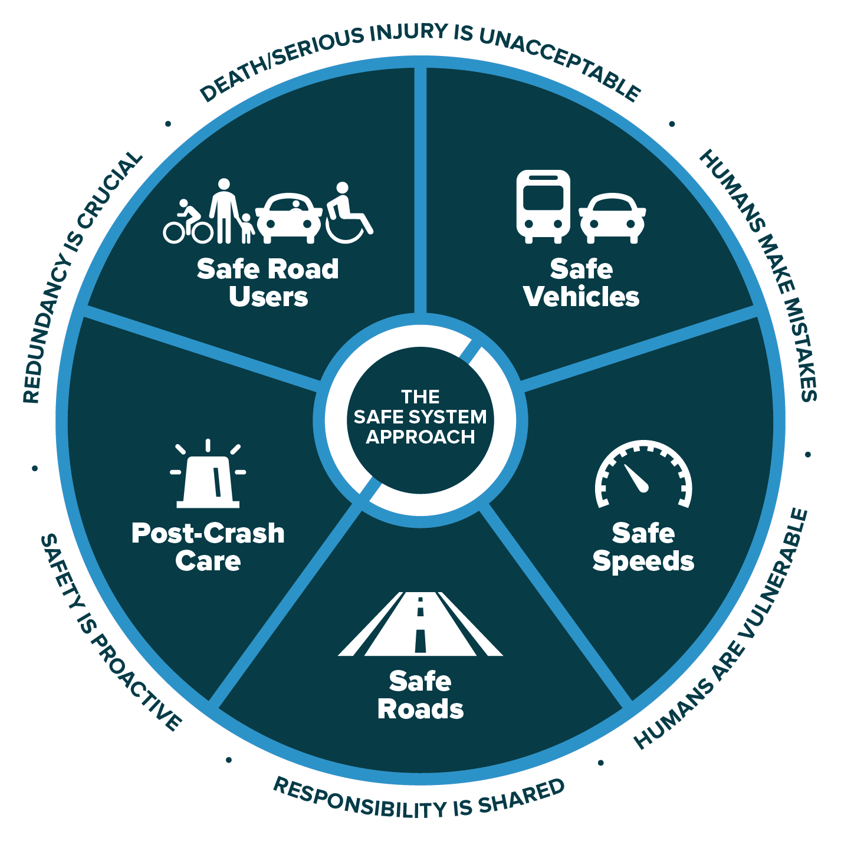

The Safe System Approach (SSA)
  Death/serious injury is unacceptable.
  Humans make mistakes.
  Humans are vulnerable.
  Responsibility is shared.
  Safety is proactive.
  Redundancy is crucial.
¹FHWA. 2020. The Safe System. FHWA-SA-20-015. Washington, DC: Federal Highway Administration. https://safety.fhwa.dot.gov/zerodeaths/docs/FHWA_SafeSystem_Brochure_V9_508_200717.pdf, last accessed November 24, 2021.
Source: FHWA⁽¹⁾.

Slide 5
The 5 Safe System
Elements Create
Redundancy
The “Swiss Cheese Model” of redundancy creates layers of protection
Death and serious injuries only happen when all layers fail
Safe road users
Safe road users
Safe vehicles
Safe vehicles
Safe speeds
Safe speeds
Safe roads
Safe roads
Post-crash care
Post-crash care
5
Source: FHWA

Slide 6



Safety in the Bipartisan Infrastructure Law (BIL)
Highway Safety Improvement Program
Safe Streets and Roads for All Program
Image Credit: © vit / stock.adobe.com
Image Credit: © deberarr / stock.adobe.com
Image Credit: © Monkey Business / stock.adobe.com

Slide 7
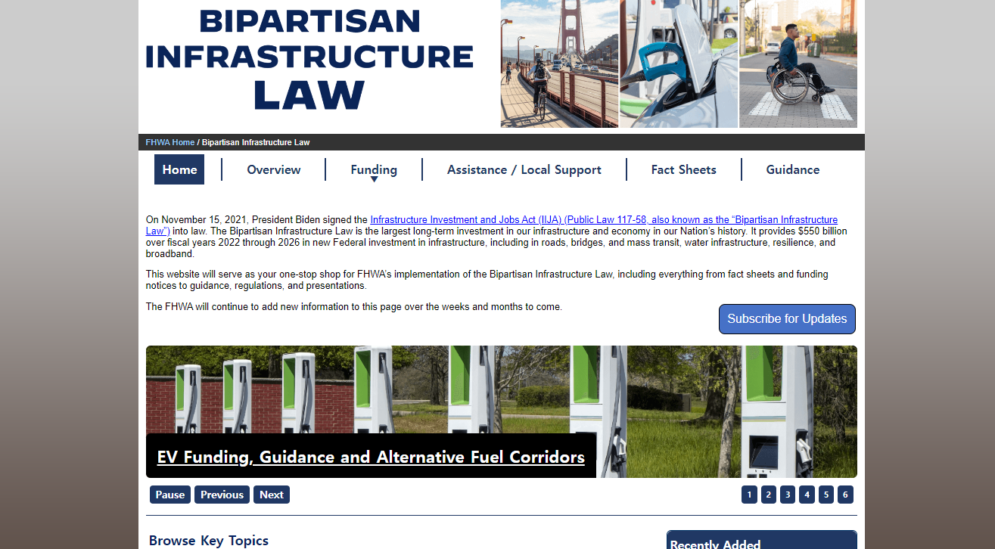

Slide 8
BIL’s Emphasis on Vulnerable Road Users (VRU)
FHWA issued the Vulnerable Road User Safety Assessment Guidance in October 2022
All States are required to develop a Vulnerable Road User Safety Assessment by November 2023

Slide 9
Q4
If you were walking across the street and struck by a car, the driver much travel no greater than what speed for you to have a 50 percent chance of survival?

Slide 10
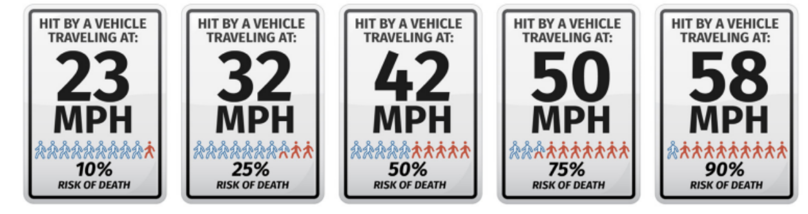
A4
National Roadway Safety Strategy, 2022

Slide 11
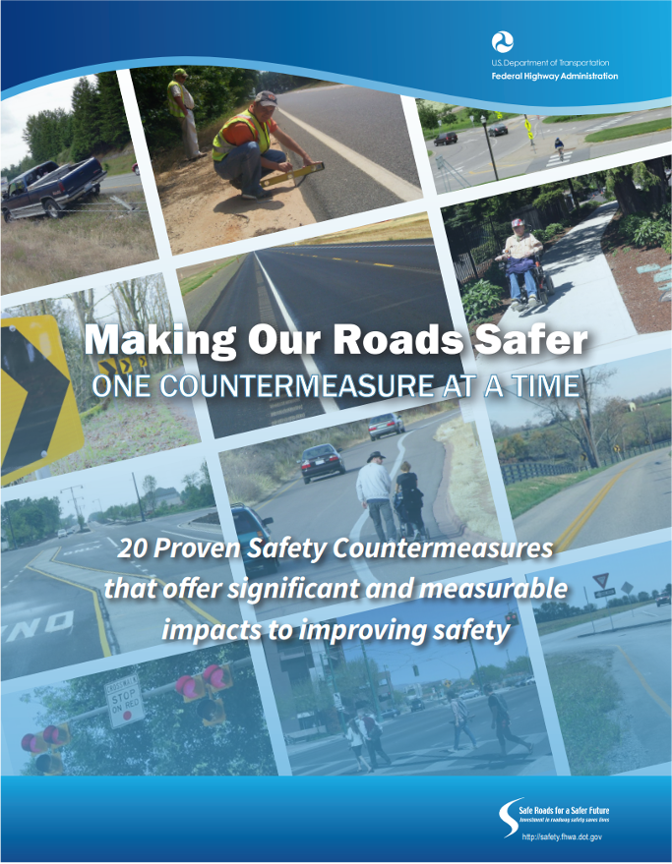
Proven Safety Countermeasures
28 countermeasures
Selection Criteria
  Proven effective
  Not widespread deployment
Guidance and Technical Assistance
Source: FHWA

Slide 12
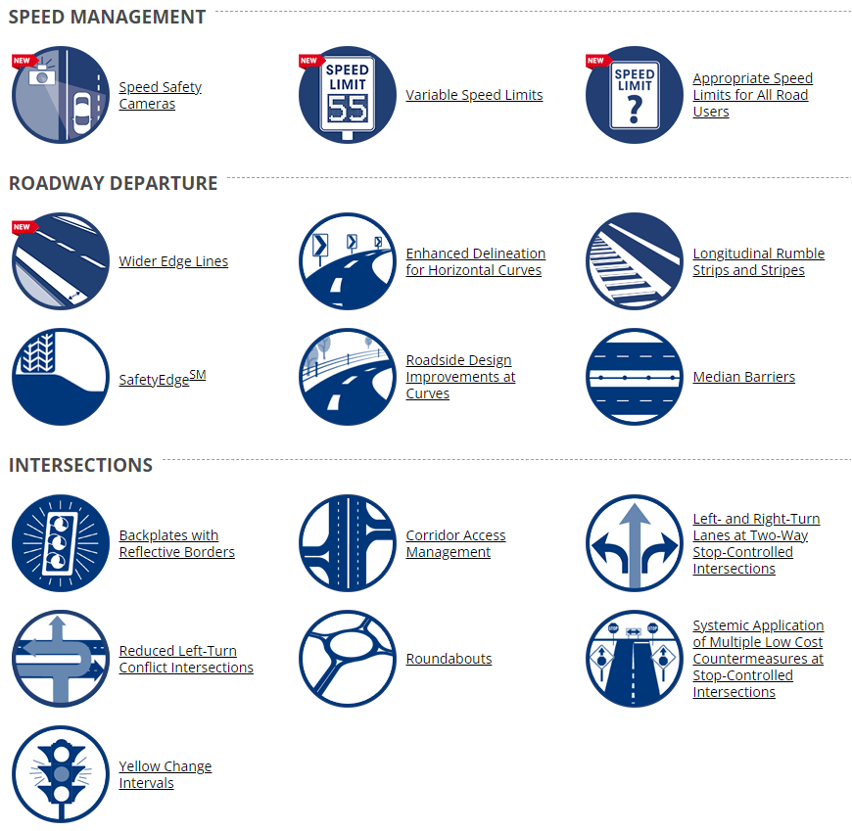
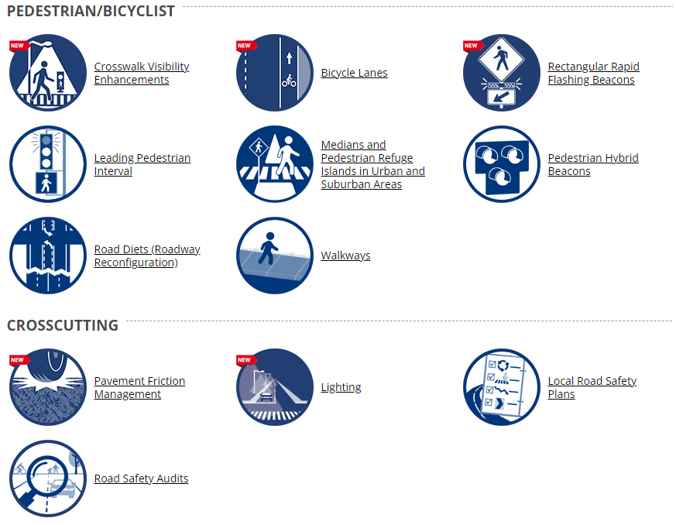
28 Proven Safety Countermeasures
Source: FHWA

Slide 13









2021 New Proven Safety Countermeasures
Rectangular Rapid Flashing Beacons (RRFBs)
Bicycle Lanes
Lighting (Intersection and Segments)
Variable Speed Limits
Crosswalk Visibility Enhancements
Speed Safety Cameras
Pavement Friction Management (CPFM and HFST)
Appropriate Speed Limits for All Road Users
Wider Edge Lines

Slide 14
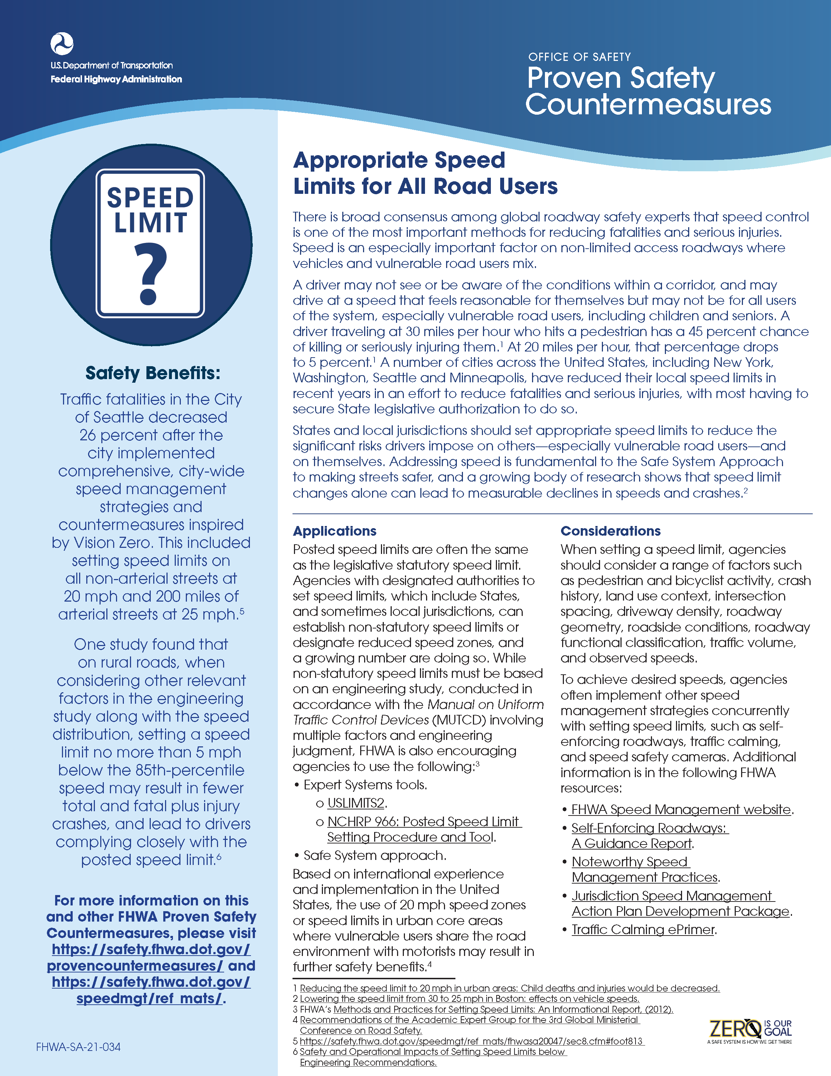
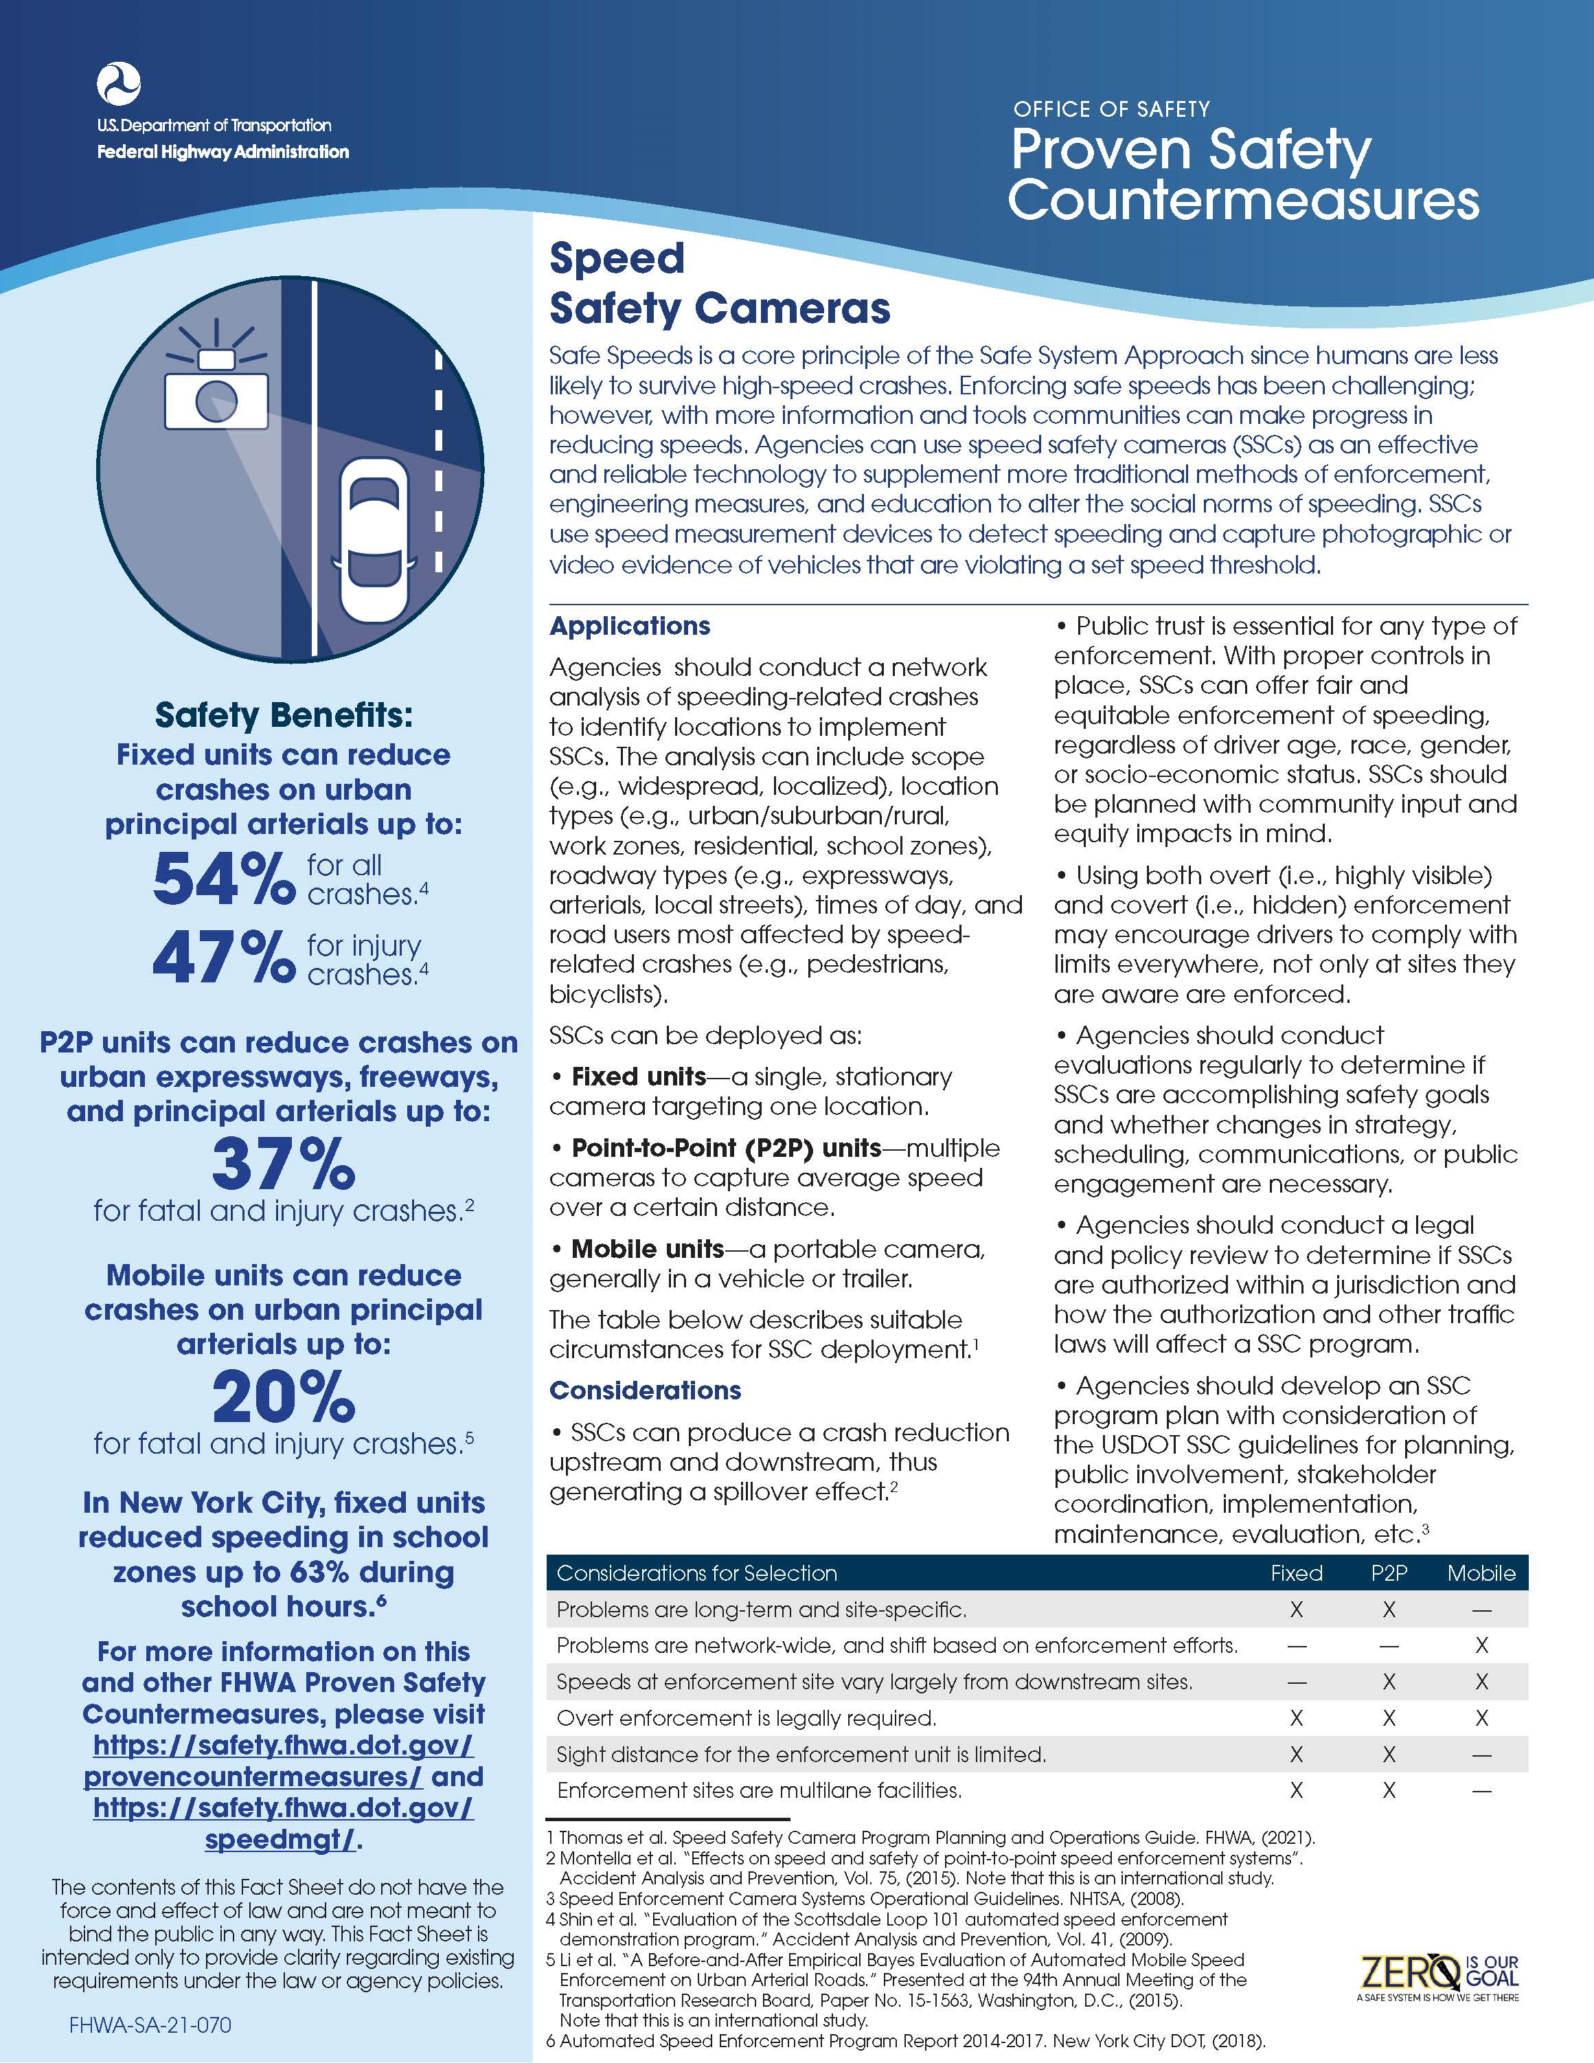
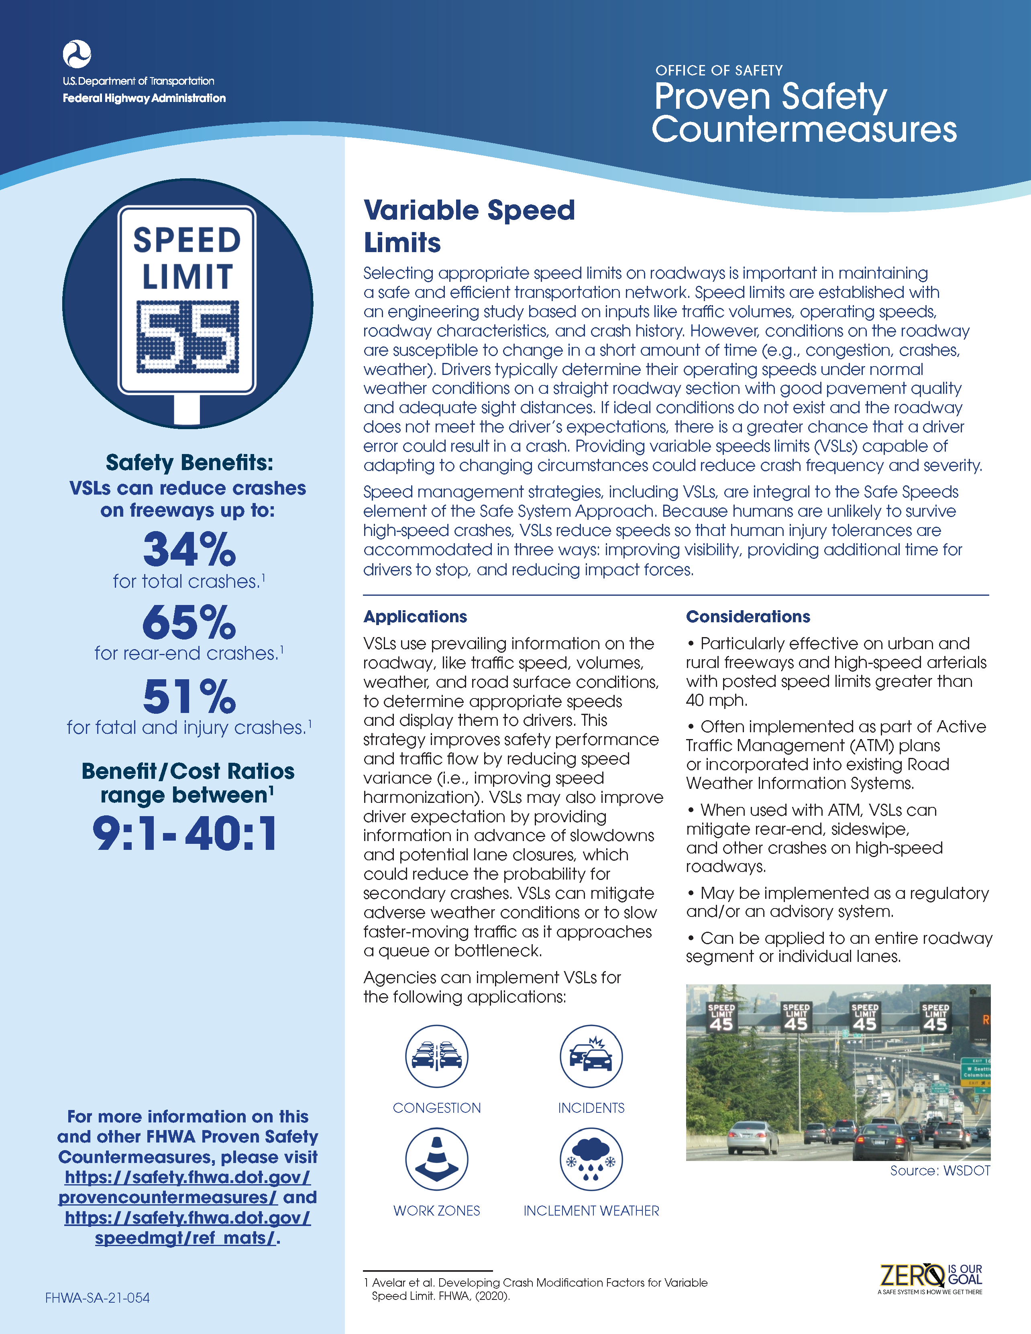
Proven Speed Management Safety Countermeasures
Appropriate Speed Limits for All Road Users
Speed Safety Cameras
Variable Speed Limits

Slide 15
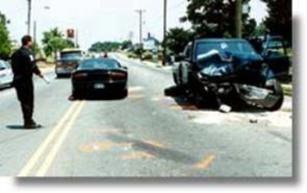
Speeding and Speed Safety
Speeding
  Impacts intersections, roadway departure, pedestrians, bicyclists impaired driving, truck rollovers, etc.
  Involves public attitudes, driver behavior, vehicle performance, roadway characteristics, enforcement strategies, court sanctions, and speed zoning
Speed
  Increases the probability and the severity of a crash
  Biggest safety impact on VRUs

Slide 16

Image Credit: © Saklakova / stock.adobe.com

